Slide 1

Grammar & Basics
Word order

Slide 2
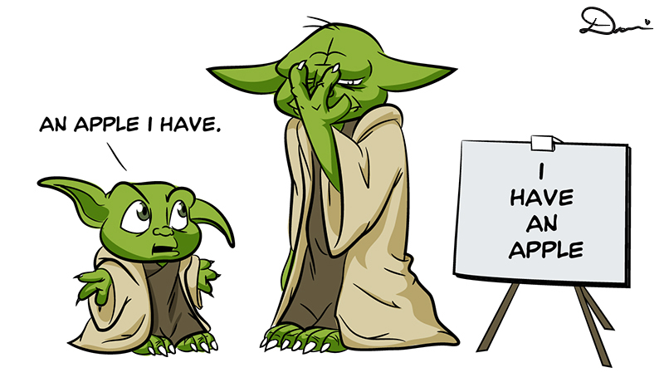
Today

Slide 3
Subject-Verb-Object

Slide 4
General word order in English and Dutch is the same:
First the one doing it (=subject), then the action (=verb)
He walks hij loopt
I can ik kan
More than one verb is possible
He has walked hij heeft gelopen
I can see Ik kan zien
Subject-Verb-Object

Slide 5
Subject-Verb-Object
Word order is always like that in English (not in Dutch!)
Then he walks Dan loopt hij
Eventually I see Uiteindelijk zie ik
The only exception is in QUESTIONS
Can I? Kan ik?
But note:
Does he walk? Loopt hij?

Slide 6
Word order with objects
Sometimes a sentence also contains the thing/person undergoing the action (= object (lijdend voorwerp))
Normal order the same in Dutch and English
I see him ik zie hem
In English all the verbs are together
I have seen him ik heb hem gezien
I can see him ik kan hem zien

Slide 7
Word order with objects
In English the verb always comes before the object
Because I see him Omdat ik hem zie
Because I have seen him Omdat ik hem heb gezien
Also for questions
Do I see him? Zie ik hem?
Have I seen him? Heb ik hem gezien?

Slide 8
Where to put words ending in –ly (adverbs)
The normal place to put them is right before the verb (this doesn’t work in Dutch)
She carefully parked the car
Ze voorzichtig parkeerde de auto
It’s also possible to put it at the end or beginning (also works in Dutch)
She parked the car carefully Ze parkeerde de auto voorzichtig
Carefully she parked the car Voorzichtig parkeerde ze de auto

Slide 9
Where to put words that indicate how often something happens
For example: always, never, often, sometimes, usually, frequently, regularly, seldom
Used before the verb
He always walks Hij loopt altijd
I always see him Ik zie hem altijd
But after forms of ‘to be’ and after the first verb if there is more than one (same in Dutch)
He is always late Hij is altijd laat
I can always see Ik kan altijd zien

Slide 10
Where to put words that indicate how often something happens
Do not put them at the beginning or end of the sentence like in Dutch
Altijd zie ik hem
Always I see him
Ik zie hem altijd
I see him always

Slide 11
Note
The same rules apply to the word also.
He also walks Hij loopt ook
I am also… Ik ben ook…
I can also see Ik kan ook zien
Also he walks Ook loopt hij
He walks also Hij loopt ook
At the end, instead of ‘also’, you can use ‘too’/’as well’
I can see too
I can see as well

Slide 12

Place and time

Slide 13
Expressions of place and time
In English expressions of place come before expressions of time
(also possible in Dutch) place> time
I am flying to London tomorrow Ik vlieg naar Londen morgen
I am working downstairs today Ik werk beneden vandaag

Slide 14
Expressions of place and time
In Dutch it’s also possible to switch them (but not in English)
Ik vlieg morgen naar Londen
I am flying tomorrow to London
Ik werk vandaag beneden
I am working today downstairs
It’s only possible if you move the time expressions to the beginning of the sentence (also in Dutch)
Tomorrow I am flying to London
Morgen vlieg ik naar London

Slide 15
